Slide 1
Graphic Design
Marc Salverda
Program Name
Goes Here
Presenter Name Goes Here
Notes:
Welcome, introduce yourself and the program. Feel free to share about your education/career background, how long you’ve been teaching, etc.

Slide 2
What is the program?
Graphic Design at Seattle Central Creative Academy
Graduates of the Graphic Design Program get to work when they leave us. We concentrate on skills for immediate entry into the job market. Our curriculum is strong on graphic design fundamentals, yet explores and adapts to emerging communication technologies. We pride ourselves in keeping our curriculum current with changes and developments on an annual basis.
Where is this program offered?
Seattle Central Creative Academy
Seattle Central College
Entry Requirements
Admission to Seattle Central College
College Composition (English 101) and Pre-Algebra (MAT 081)
Portfolio Review

Slide 3
History and Fun Facts
A little bit about the Graphic Design program at Seattle Central
Established in 1949 as the Advertising Arts program
Part of Broadway-Edison Technical School
Tuition in 1946 was two dollars per quarter
In 1966, Edison became part of Seattle Community College
In 2007, the Seattle Central Creative Academy was formed Students enjoy an $8 million dollar facility that features integrated classes and shared resources, plus studios and labs that simulate real-world, professional environments.
Most recent Alumni polls (2018, 2019 & 2020) result highlights
60% of students were making $35,000.00 or less when they started
70% were making over $55,000.00 in their first job after graduation
62% of graduates found full time employment in 3 months or less
30% had a full-time job in less than a month from graduation

Slide 4
What do you learn?
In our most recent industry survey
70% responded they saw the demand for designers in the Seattle area increasing over the next 5 years.
We currently have over 600 members in our Alumni group
We have an alumni job board on LinkedIn
The curriculum
30 Courses over two years – 20 Credits per quarter
Lockstep, only start in the Fall
Classes meet once a week, five days a week from 9:00am to 2:00pm, except Friday 9:00am to 3:00pm for New Media.
11-week quarters with no classes during the summer
Required Internship, 3 credits, 99 hours
Classes are a mix of lecture, demonstrations, critiques and lab time.
Two-year program, Associate of Applied Science degree
Upside down articulation with Western Washington and Evergreen

Slide 5
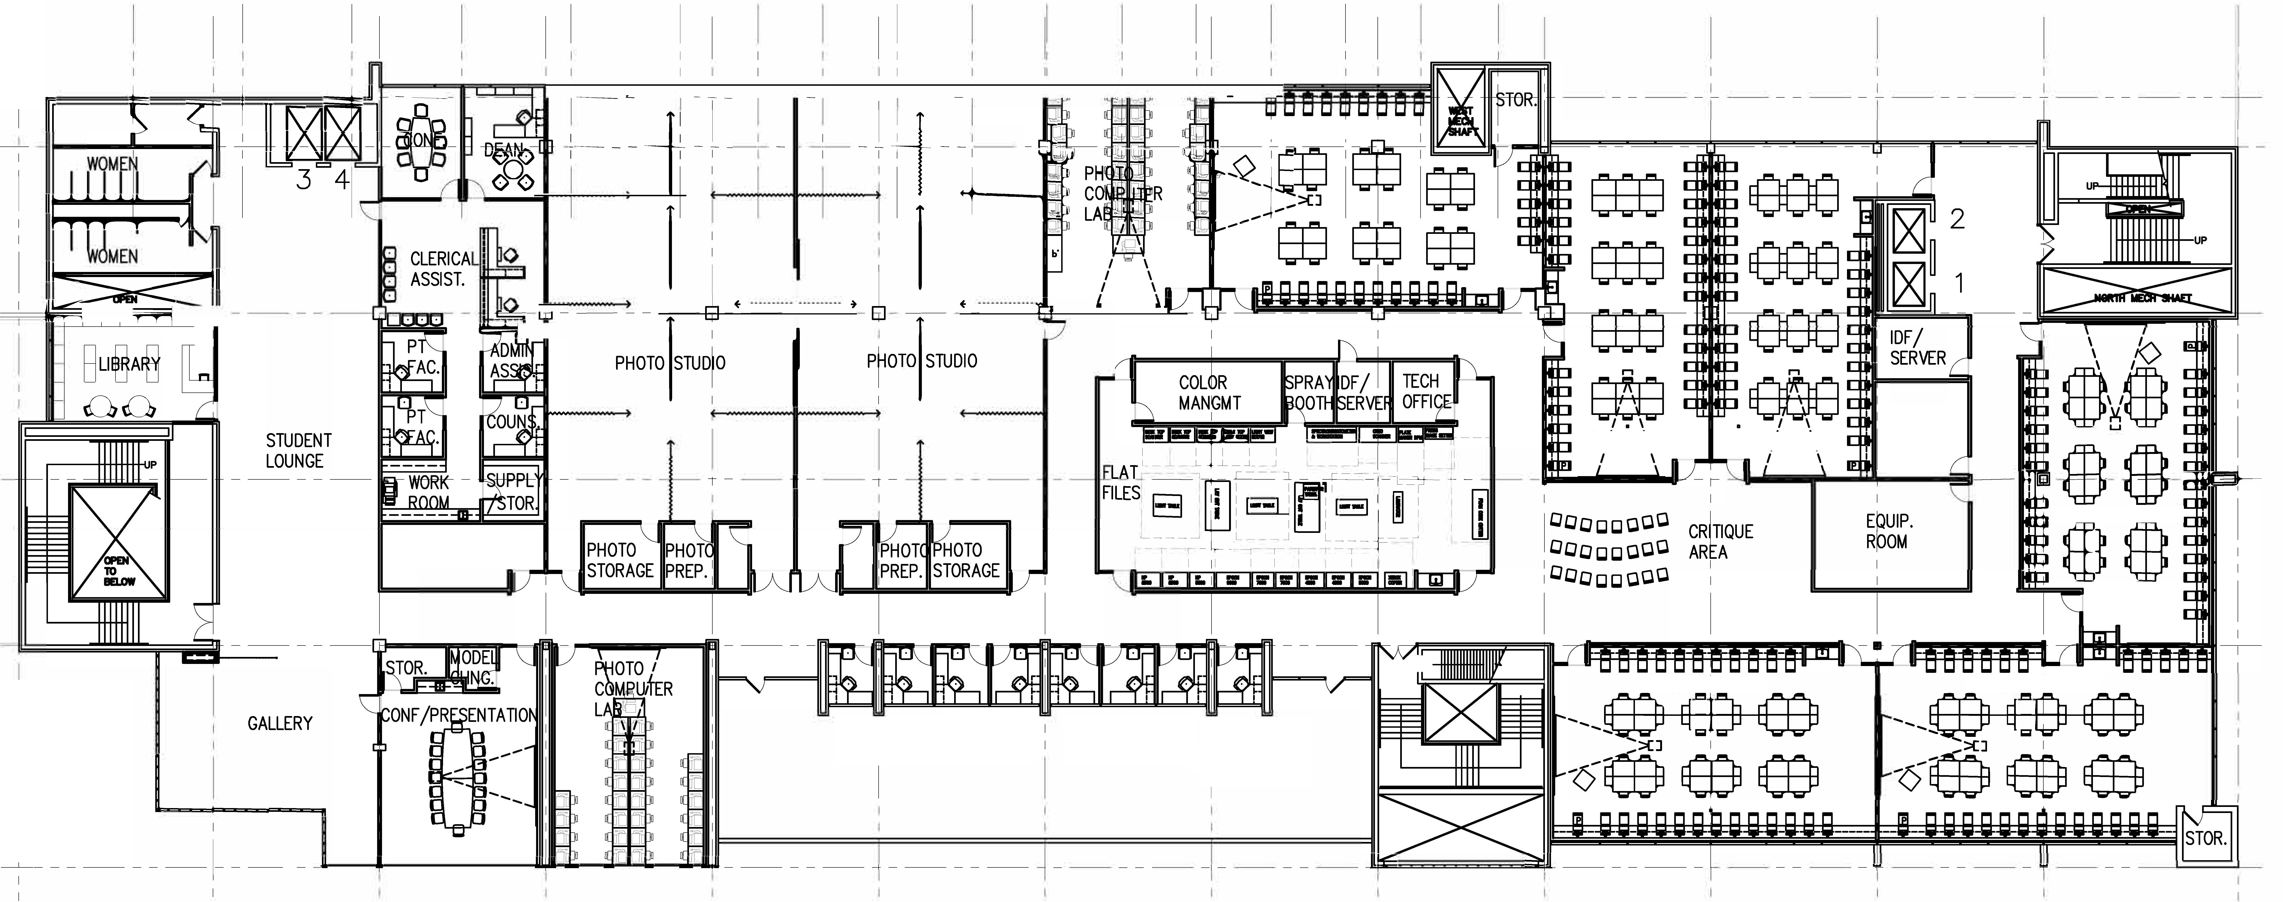
Our Space

Slide 6
Careers/Jobs
Information from Glassdoor.com for jobs in the Seattle Area – 4/20/2021
Graphic Designer
Average Base Pay $54,649 / year
333 graphic designer Jobs in Seattle, WA
Graphic Production
Average Base Pay $58,607 / year
74 graphic production artist Jobs in Seattle, WA
Animator
Average Base Pay $75,606 / year
65 animator Jobs in Seattle, WA
Designer Researcher
Average Base Pay $75,787 / year
625 designer researcher Jobs in Seattle, WA
Visual Designer
Average Base Pay $81,000 / year
814 visual designer Jobs in Seattle, WA
Motion Designer
Average Base Pay $86,024 / year
165 motion designer Jobs in Seattle, WA
Ui (User Interface) Designer
Average Base Pay $101,244 / year
430 Ui designer Jobs in Seattle, WA
UX (User Experience) Designer
Average Base Pay $111,062 / year 460 UX designer Jobs in Seattle, WA
Product Designer
Average Base Pay $116,280 / year
723 product designer Jobs in Seattle, WA
Currently 3065 Jobs
in the Seattle Area

Slide 7
Careers/Jobs
51 Eggs
8ninths
Aardvark Design Labs
Agoda
Alaska Airlines
Allis Studio
Amazon
Apple
AQUENT
Autodesk
Avalara
AWS
Bevy
Blindtiger Design
Blink UX
Boeing
Bread N Butter
Brick and Pixel Design
Brit VG Design
Brooks
Buchino, LLC
Bungie
Callaway Golf
Camp Doug
CBS Interactive
Center
Cole & Weber
Color
Concur
Creative Circle
Deloitte Digital
Dropbox
Elemis
Everett Community College
EveryPoint
Exact Image
Freelance
Committee for Children
Facebook
Fresh
Garrigan Lyman Group GreenRubino
Gillian Levine Design, LLC
Golden Lasso
Google
Gravity Creative
HBO
Hornall Anderson
Hostwinds
HummingTree
Infosys
Interior Architects
Kalakala Animation
KLM Royal Dutch Airlines
Long Playing Communication + Design
Marco Polo
McKinstry
Microsoft
MiiR
Mix Plate Media
ModusBox
Moz
Museum of Pop Culture
NBBJ
Nike Inc.
Nordstrom
Onehub
Open
PicMonkey
Pike Place Market PDA
Pilot Lab
Pipette & ZoomCare
Polly.ai
Practicery
PRR
Publicis Experiences
Purpose & Co.
RAM Mounts
Rational Interaction
Ravensburger
Redfin
REI Co-op
Retired faculty
Rock Paper Sketch
Rocket Park Design
RUN Studios/Microsoft
SAP
Seattle Kraken Hockey
SID LEE
Spotify R&D
Squarespace
Stack resources
Starbucks
STORD
Strum
Lustre
T-Mobile Creative Studio
Territory
Tether
Tinuiti
Tiny Sandwiches
True Brands
University of Washington
Unsung Studio
VF Corp
VVS (very very spaceship)
Wick & Mortar
Wongdoody
ZTUDIO
Zulily

Slide 8
What we do
This is what we do
http://seattlecentralcreativeacademy.com/
https://www.instagram.com/creative_academy/
If asked about college admissions, advising, etc. and you don’t have the answer, encourage students to stick around for help from 4:30-5pm.

Slide 9
Talking Points
Website
Overview
The program is competitive – Portfolio
2/3 of students have a bachelor’s degree and are making a career change
Average age 28
Must maintain a 2.0 grade point in every class
Five-hour classes with 3 to 5 hours of homework each day
Courses
Lockstep, only start in the Fall
Classes meet once a week, five days a week from 9:00am to 2:00pm, except Friday 9:00am to 3:00pm for New Media.
11-week quarters with no classes during the summer
Required Internship, 3 credits, 99 hours
Classes are a mix of lecture, demonstrations, critiques and lab time.
Two-year program, Associate of Applied Science degree
Upside down articulation with Western Washington and Evergreen

Slide 10
Talking Points
Apply
Admission to Seattle Central College
Academic Requirements
Advising – Fill out a FAFSA form no matter what
Portfolio Review
Portfolio Submission Dates
Open House
Spring 2021 – May 5th – 5:30 to 6:30pm
Enrollment and Registration information will be sent to you
Enrollment meeting – If we are back on campus
Portfolio Shows
Two nights – Professionals & Friends and Family
FAQ
Contact Info
If asked about college admissions, advising, etc. and you don’t have the answer, encourage students to stick around for help from 4:30-5pm.

Slide 11
Return to Main Session
(select “Leave Breakout Room” to return)

